Slide 1

Title of your Project
Bhumi Koli 25207010
Kashish Jain 24107031
Sanika Pawar 25207015
Namrata Dhas 25207012
Project Guide
Ms. Sarala Mary

Slide 2
Contents
Introduction
Objectives
Scope
Features / Functionality
Project Outcomes
Technology Stack
Block Diagram

Slide 3
1. Introduction
Problem Identified :
Citizens find it difficult to report public issues like road damage, garbage, water leakage, and streetlight problems.
Complaints are often delayed because there is no proper system to track them.
Solution Proposed :
A mobile application where users can submit complaints with photo and location.
Complaints are stored in a database and sent to authorities, and users can track the status in real time.

Slide 4
2. Objectives
Objective 1 — Complaint Submission with Multimedia and Location Support Enable users to register public issues by providing a text description, category selection, real-time photo uploads, and precise GPS location.
Objective 2 — Community-Driven Priority and Voting System Implement a polling mechanism for every complaint, allowing citizens to vote and prioritize issues so that high-demand repairs are addressed first by authorities.
Objective 3 — Volunteer and NGO Collaboration Platform Create a module where individual volunteers and NGOs can discover and sign up to assist with specific tasks like cleaning or local maintenance to expedite resolutions.
Objective 4 — Status Tracking and Evidence-Based Verification Provide a real-time tracking system (Pending, In Progress, Resolved) that requires "Before" and "After" photo documentation as digital proof of work completion.

Slide 5
3. Scope
Can be used in cities and municipal offices to report problems like road damage, garbage, or water leakage.
Useful for citizens to easily send complaints with photo and location through a mobile app.
Helps authorities to track complaints and solve problems faster.

Slide 6
4. Feature /Functionality
Feature 1 : Complaint Submission
Users can submit complaints by entering a description, selecting a category, and uploading a photo. The app also captures the GPS location of the issue.
Feature 2 : Image and Location Support
The system uses Flutter Camera API to capture images and Google Maps API to detect the exact location of the problem.
Feature 3 : Complaint Tracking System
Users can track the status of their complaints such as Pending, In Progress, and Resolved. The data is stored and updated using Firebase backend.

Slide 7
5. Outcome of Project
User can register and log in to the application.
User can submit complaints with photo and location.
Complaints are stored in Firebase database.
Admin can view and update complaint status.
User can track complaint status (Pending, In Progress, Resolved).

Slide 8
6. Technology Stack
Frontend (GUI) : Flutter
Backend / Database : Firebase
APIs Used : Flutter Camera API, Google Maps API

Slide 9
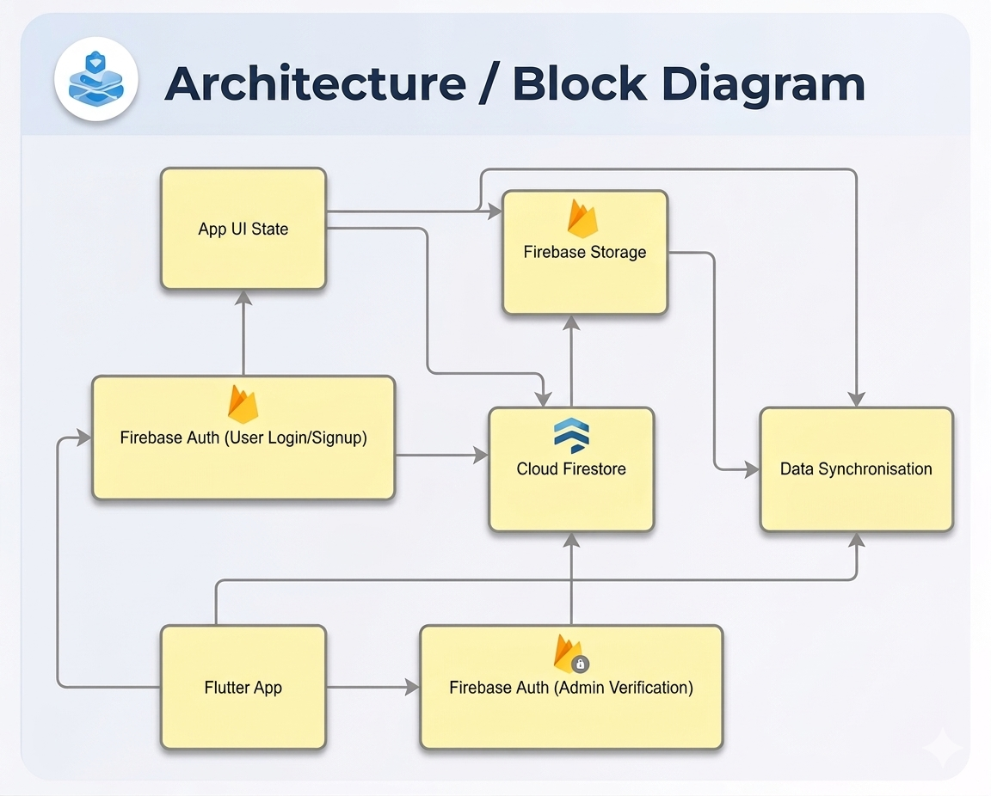
7. Block Diagram ( if applicable)

Slide 10
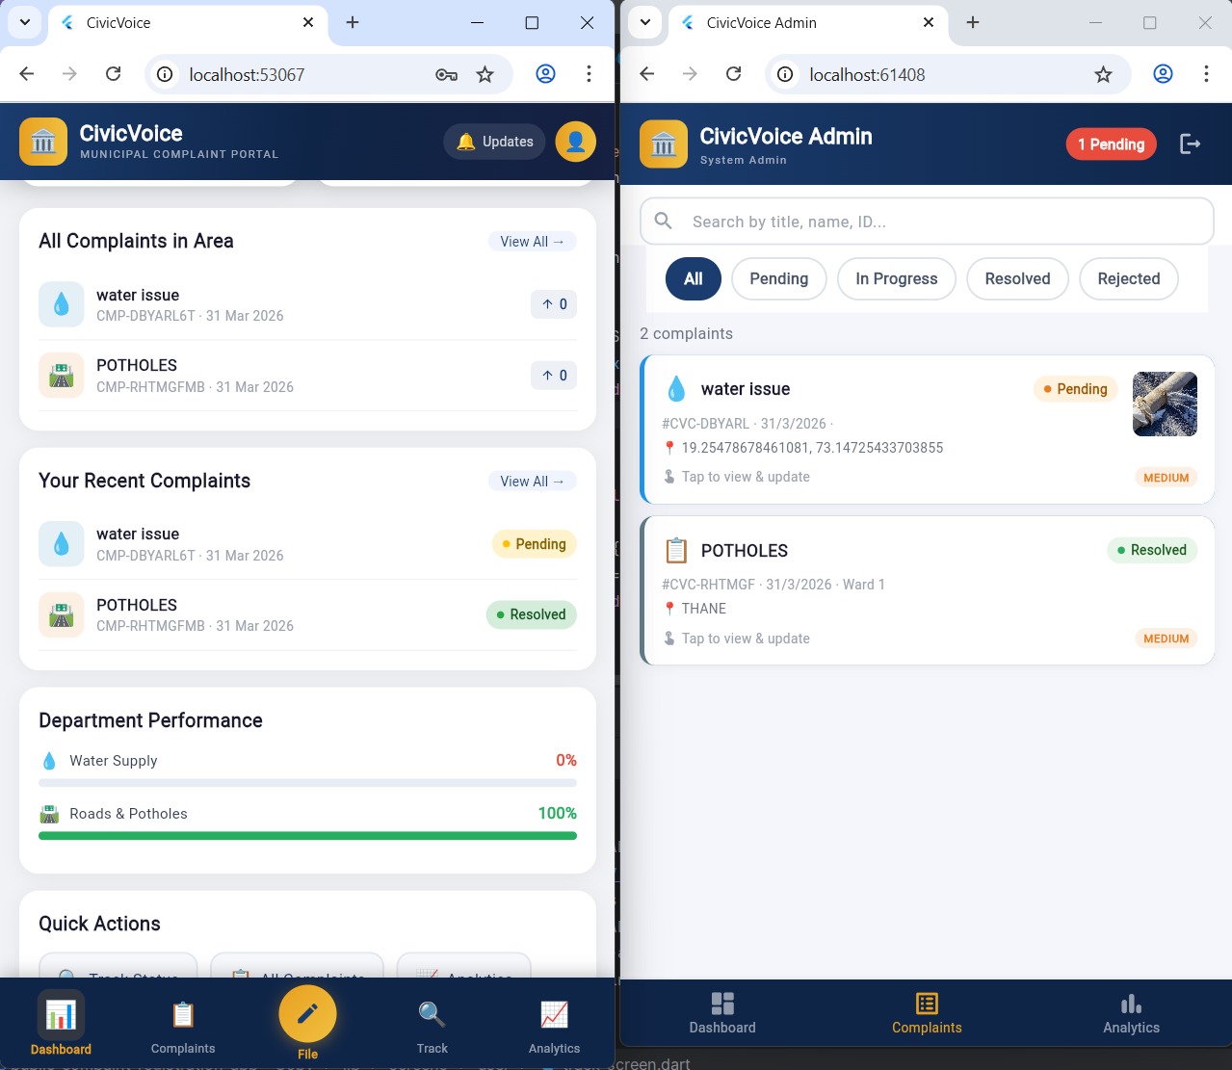
Application Output

Slide 11
Thank You...!!

